Slide 1
Final defense
An integrated heralded single photon source based on STIRAP
and Ti-PPLN waveguides
Supervisor: Yen-Hung Chen
Student: Yang-Teng Li

Slide 2
Outline
Final defense
1
Introduction
4
Fabrication process
Integrated heralded single photon sources
Integrated PBSs
Integrated spectral filters
Titanium in-diffusion
Electric field poling
5
Results and discussions
2
Theory
Tuning curve of SFG
PER spectrum
Coincidence counting
Sum frequency generation/SPDC
Quasi-phase-matching
Electric field poling
Stimulated Raman adiabatic passage (STIRAP)
6
Conclusion and outlook
3
Simulation
Polarization beam splitters based on STIRAP
High-pass filters based on STIRAP

Slide 3
Introduction
Final defense

Slide 4

Introduction
Theory
Simulation
Fabrication process
Results and discussions
Conclusion and outlook
Classical vs. quantum system
Final defense
Classical
Quantum
Bits (binary)
Locality
Data encryption based on computation power
Qbits (Superposition)
Entanglement
Data encryption based on Non-cloning theorem

Slide 5


Introduction
Theory
Simulation
Fabrication process
Results and discussions
Conclusion and outlook
Atom vs. single photon
Final defense
Atom
Photon
The highest fidelity
Operated at cryogenic temperature
Superconducting technologies are required
Relatively lower fidelity
Operated at room temperature
Compatible with all fiber network devices

Slide 6
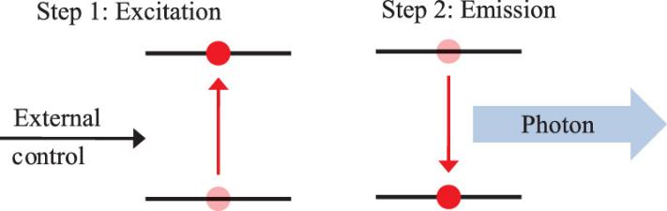
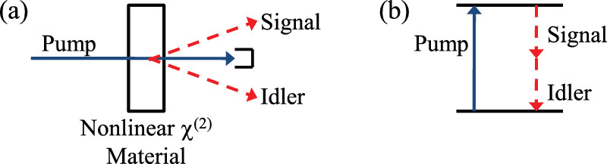
Introduction
Theory
Simulation
Fabrication process
Results and discussions
Conclusion and outlook
Deterministic vs. probabilistic
Final defense
Deterministic
Probabilistic
Emitting single photons on-demand
Operated at cryogenic temperature
Magneto-optical trap and optical cavity are required
Unavoidable emission/extraction loss
Emitting photons with a probability distribution
Operated at room temperature
On chip integration of all functionalities
Fully engineerable nonlinearity
Invited review article: Single-photon sources and detectors. Review of scientific instruments, 82(7):071101, 2011.

Slide 7
Introduction
Theory
Simulation
Fabrication process
Results and discussions
Conclusion and outlook
Schematic of heralded single photon sources
Final defense
Stage 1
Stage 2
Stage 3
Pump filter
PBS
Pump
SPD
Triggering signals
SPDC source
Signal photons
Photon pairs
(single + idler photons)
Photon pairs
(single + idler photons)
+
Idler photons
Pump photons
Triggered SPD

Slide 8
Introduction
Theory
Simulation
Fabrication process
Results and discussions
Conclusion and outlook
Integrated heralded single photon sources
Final defense
Stage 1
Stage 2
Stage 3
Pump filter
PBS
+
+
SPDC source
Requirements
Efficient nonlinear frequency conversion
Post temperature tuning
Post wavelength tuning
Requirements
High fabrication tolerance
Broadband operation of ER > 20 dB
Requirements
High fabrication tolerance
Broadband operation of PER > 20 dB

Slide 9
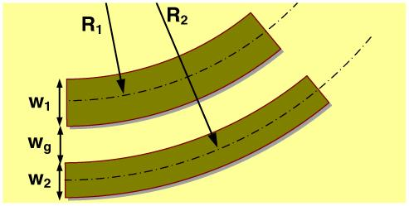
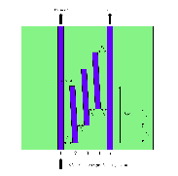
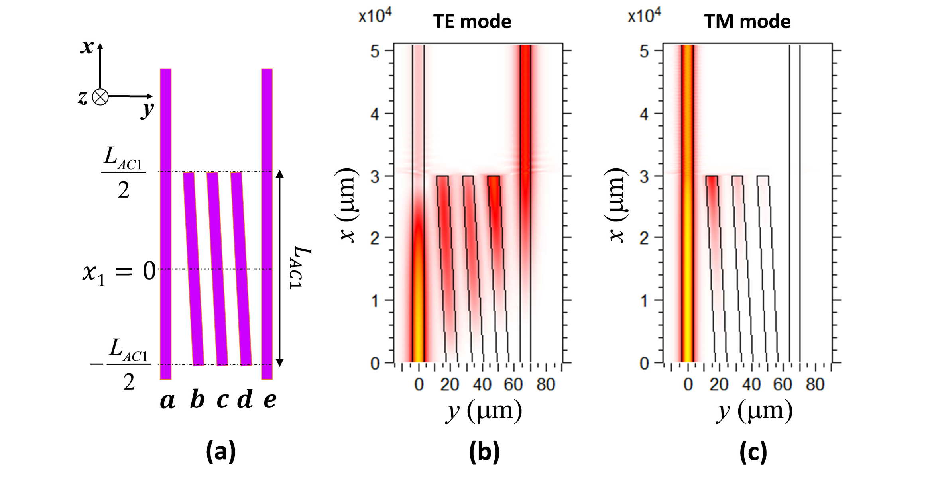
Introduction
Theory
Simulation
Fabrication process
Results and discussions
Conclusion and outlook
The most commonly used PBS design
Final defense
DC
The proposed design
Adiabatic coupler
The smallest footprint
High ER for the TE mode
Limited PER bandwidths
Fabrication tolerant
A moderate device length
Broadband operation of high PER
Fabrication tolerant
Limited transmission bandwidths
The longest device length
Broadband operation of high PER
Fabrication tolerant
Novel ultra-short and ultrabroadband polarization beam splitter based on a bent directionalcoupler. Optics express, 19(19):18614–18620, 2011.
Broadband on-chip polarization mode splitters in lithium niobate integrated adiabatic couplers. Optics express, 27(2):1632–1645, 2019.

Slide 10
Introduction
Theory
Simulation
Fabrication process
Results and discussions
Conclusion and outlook
The proposed design
Final defense
DC
The proposed design
Adiabatic coupler
The smallest footprint
High ER for the TE mode
Limited PER bandwidths
Fabrication tolerant
A moderate device length
Broadband operation of high PER
Fabrication tolerant
Limited transmission bandwidths
The longest device length
Broadband operation of high PER
Fabrication tolerant

Slide 11
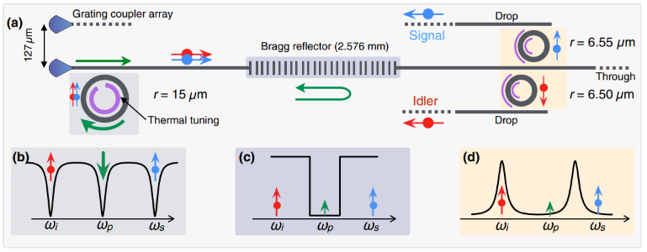
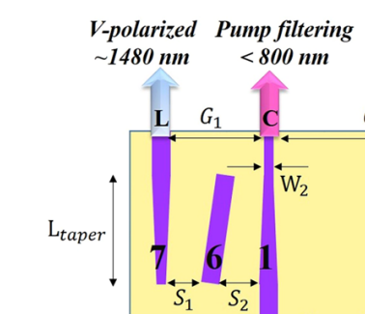
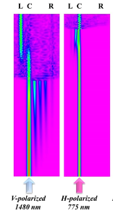
Introduction
Theory
Simulation
Fabrication process
Results and discussions
Conclusion and outlook
The most commonly used designs of pump filters
Final defense
FBGs/ring resonators
Adiabatic coupler
The highest pump isolation
Strict technology steps
Critical alignments
Narrowband operation
Relatively smaller isolation
Fabrication tolerant
Naturally high-pass and broadband
Novel ultra-short and ultrabroadband polarization beam splitter based on a bent directionalcoupler. Optics express, 19(19):18614–18620, 2011.
Broadband on-chip polarization mode splitters in lithium niobate integrated adiabatic couplers. Optics express, 27(2):1632–1645, 2019.

Slide 12
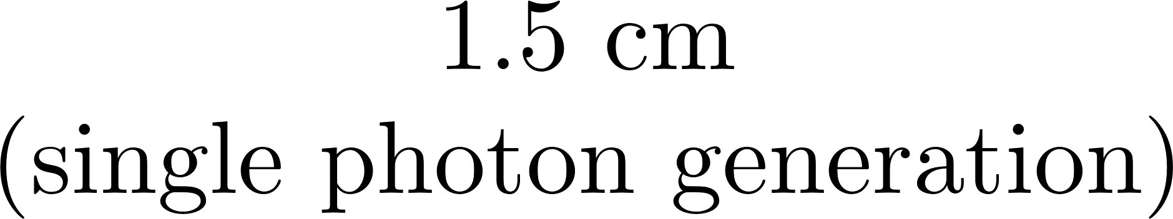


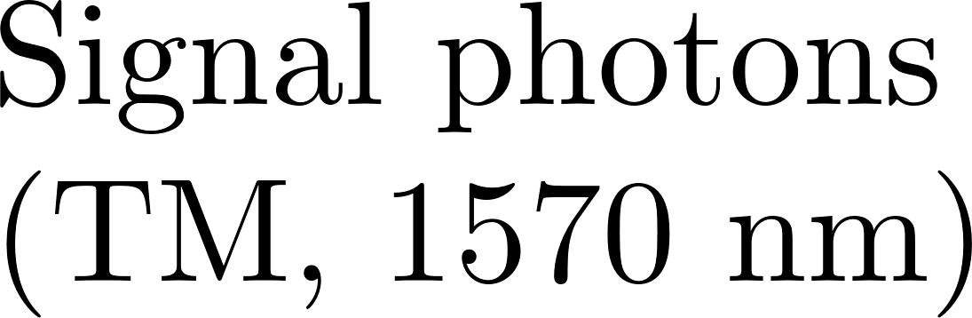
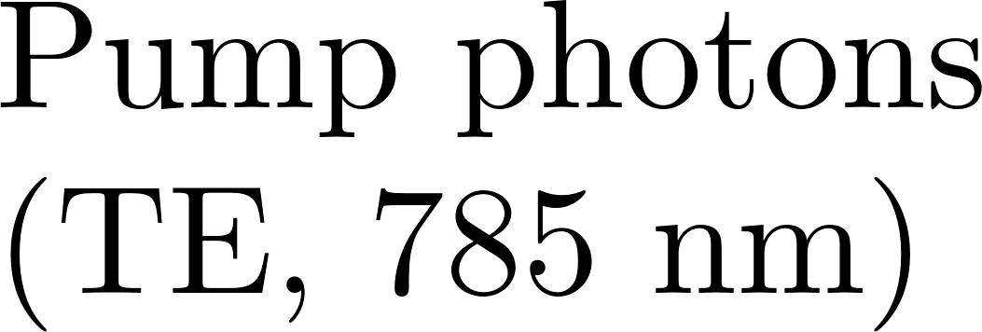


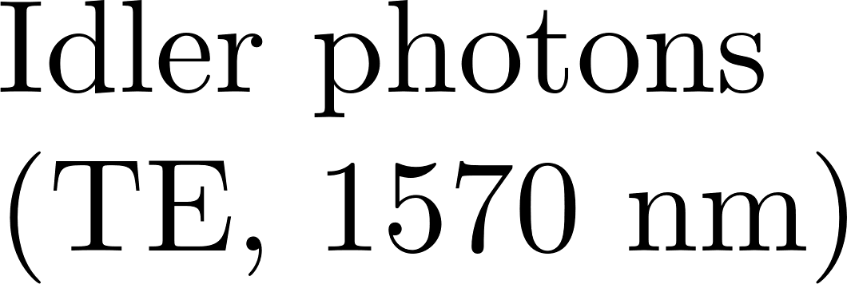
Introduction
Theory
Simulation
Fabrication process
Results and discussions
Conclusion and outlook
The proposed design
Final defense

Slide 13
Theory
Final defense

Slide 14



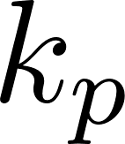


Introduction
Theory
Simulation
Fabrication process
Results and discussions
Conclusion and outlook
Sum frequency generation/SPDC
Final defense
Nonlinear frequency conversion
Energy conservation
Phase matching condition
SFG (classical)
Perfect phase matching
SPDC (quantum)

Slide 15
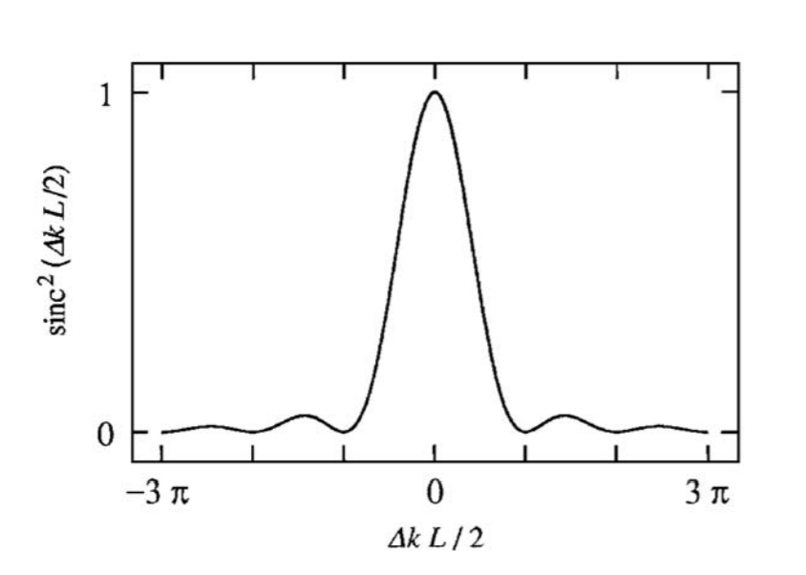

Introduction
Theory
Simulation
Fabrication process
Results and discussions
Conclusion and outlook
Phase matching condition
Final defense
Under low conversion approximation, the output SFG power increases linearly with signal and idler power, quadratically with nonlinear coefficient and crystal length
Robert W. Boyd. Nonlinear Optics, Third Edition. Academic Press,Inc., USA, 3rd edition, 2008.

Slide 16
Introduction
Theory
Simulation
Fabrication process
Results and discussions
Conclusion and outlook
Quasi phase matching
Final defense
Phase compensation
In phase
Out of phase (π)
In phase
Out of phase (π)
Nonlinear crystal
-π
Nonlinear crystal
Coherence length
Coherence length

Slide 17
Introduction
Theory
Simulation
Fabrication process
Results and discussions
Conclusion and outlook
Quasi phase matching
Final defense
Since the sign of nonlinear coefficients depends on the crystalline axis, reversing the axis will result in additional minus sign (π phase shift), thus compensates the accumulated phase mismatch
In phase
Out of phase (π)
In phase
Out of phase (π)
Flip
Coherence length
Coherence length

Slide 18
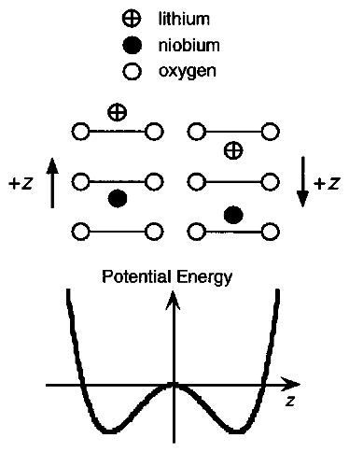
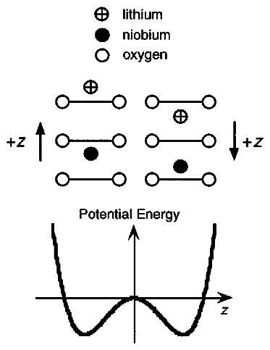
Introduction
Theory
Simulation
Fabrication process
Results and discussions
Conclusion and outlook
Electric field poling
Final defense
Domain reversal occurs when applying a voltage exceeds a certain value on a ferroelectric material (21 kV/mm for lithium niobite)
Applying high voltage
(21 kV/mm)
L. E. Myers, R. C. Eckardt, M. M. Fejer, R. L. Byer, W. R. Bosenberg, and J. W. Pierce, "Quasi-phase-matched optical parametric oscillators in bulk periodically poled LiNbO3," J. Opt. Soc. Am. B 12, 2102-2116 (1995)

Slide 19
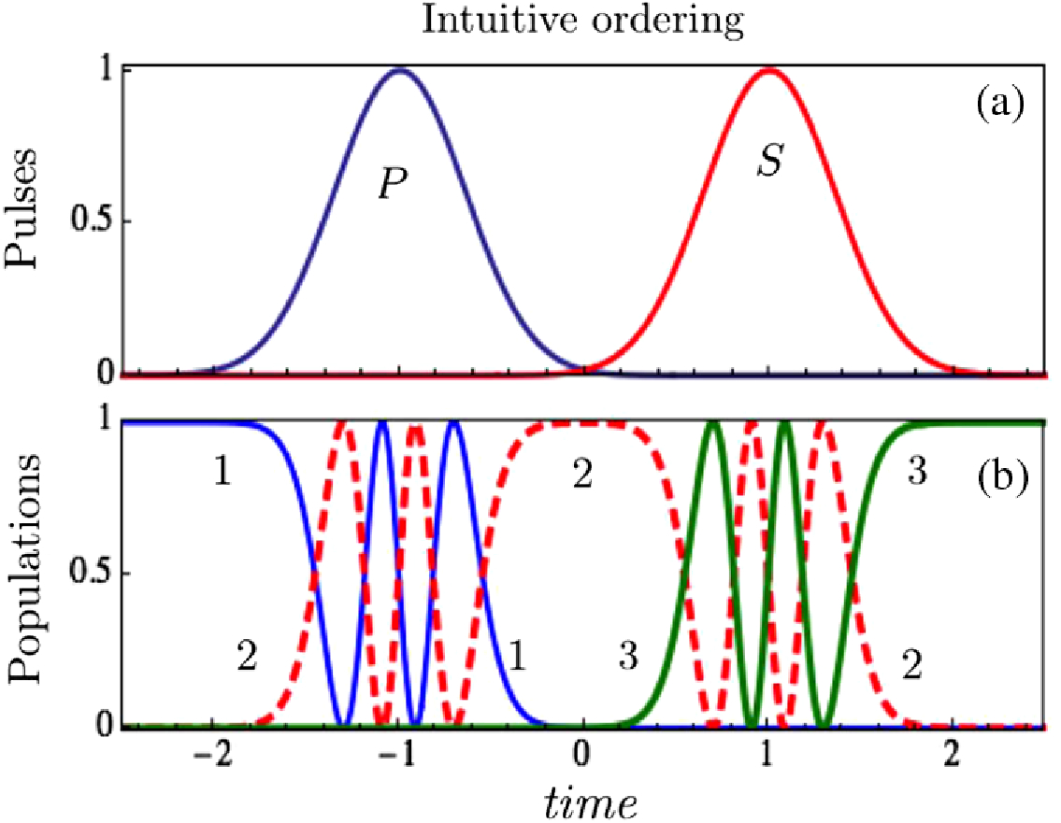





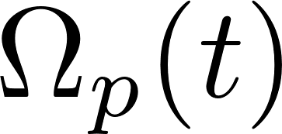


Introduction
Theory
Simulation
Fabrication process
Results and discussions
Conclusion and outlook
Rabi oscillations (intuitive ordering)
Final defense
The pump pulse is first sent to transfer the population from state |1⟩ to intermediate state |3⟩, then a Stoke pulse sent after transfers the population to |2⟩
Because when undergoing each process, these states are strongly coupled, thus a series of population inversion occurs (Rabi oscillation)
[1] Picturing stimulated Raman adiabatic passage: a STIRAP tutorial," Adv. Opt. Photon. 9, 563-719 (2017)

Slide 20
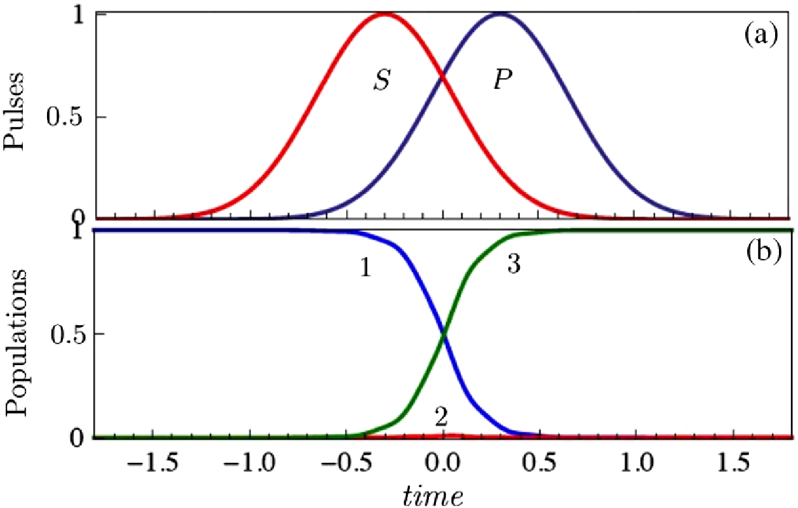
Introduction
Theory
Simulation
Fabrication process
Results and discussions
Conclusion and outlook
Adiabatic passage (counter-intuitive ordering)
Final defense
If the pulse ordering is reversed and the evolution of pulse intensity is sufficiently slow, the population will be completely transferred to ∣3〉without exciting intermediate level. Unlike the intuitive case, such scheme is robust against experimental variations.
Counter-intuitive ordering
[1] Picturing stimulated Raman adiabatic passage: a STIRAP tutorial," Adv. Opt. Photon. 9, 563-719 (2017)

Slide 21
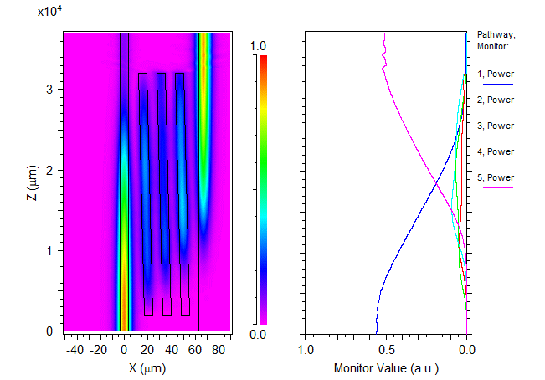
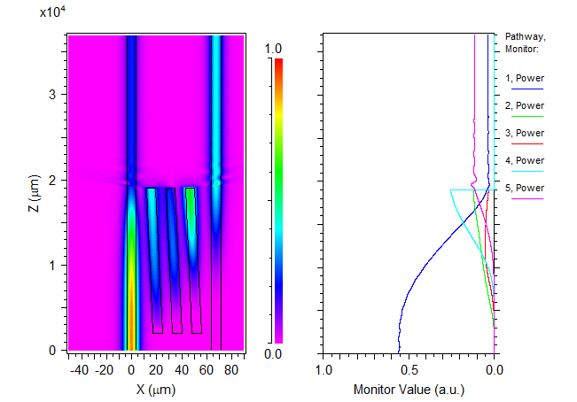
Introduction
Theory
Simulation
Fabrication process
Results and discussions
Conclusion and outlook
The previous design
Final defense
Since Ti-diffused waveguides only provide small birefringence, the number of intermediate states is chosen as 3 to further increase the PER
However, if the coupling length is directly shortened, the adiabaticity of the system would be greatly reduced, making the conversion incomplete
Broadband on-chip polarization mode splitters in lithium niobate integrated adiabatic couplers. Optics express, 27(2):1632–1645, 2019.

Slide 22
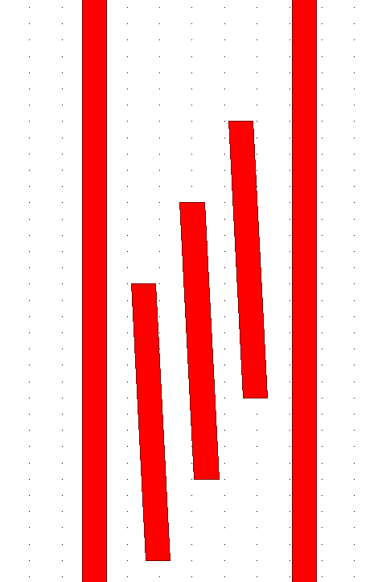




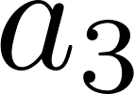


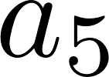
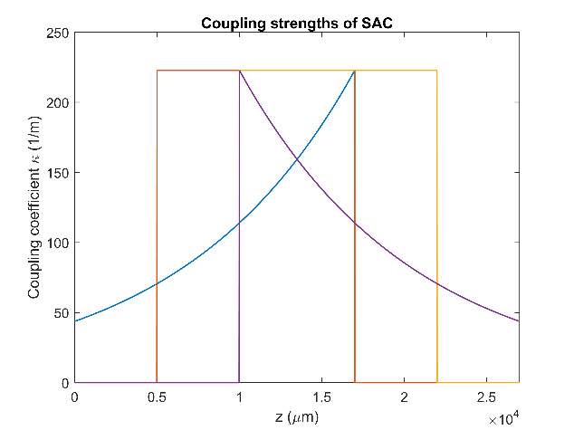
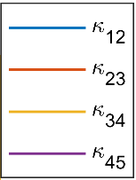
Introduction
Theory
Simulation
Fabrication process
Results and discussions
Conclusion and outlook
The proposed design
Final defense
The proposed design
To reduce the coupling length, the duration of pulses is shortened from 3 cm to 1.7 cm
1/3 delay
However, decreasing the coupling length inevitably reduces “adiabaticity”
By introducing a 1/3 delay between each pulses, the overall interaction is still “adiabatic”, while the effective coupling length remains 1.7 cm

Slide 23
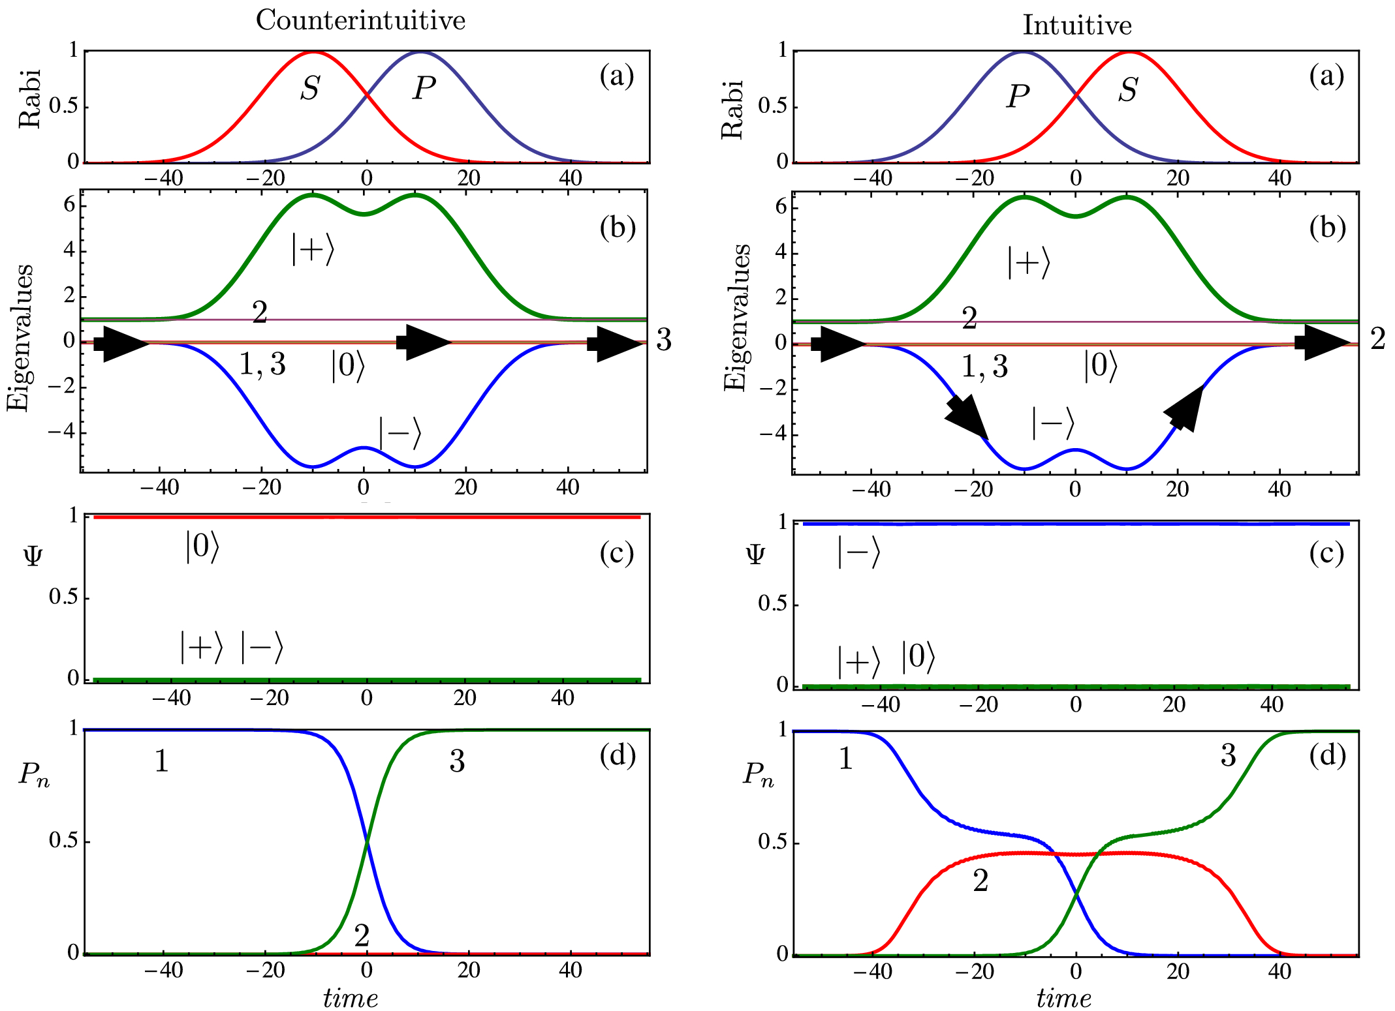
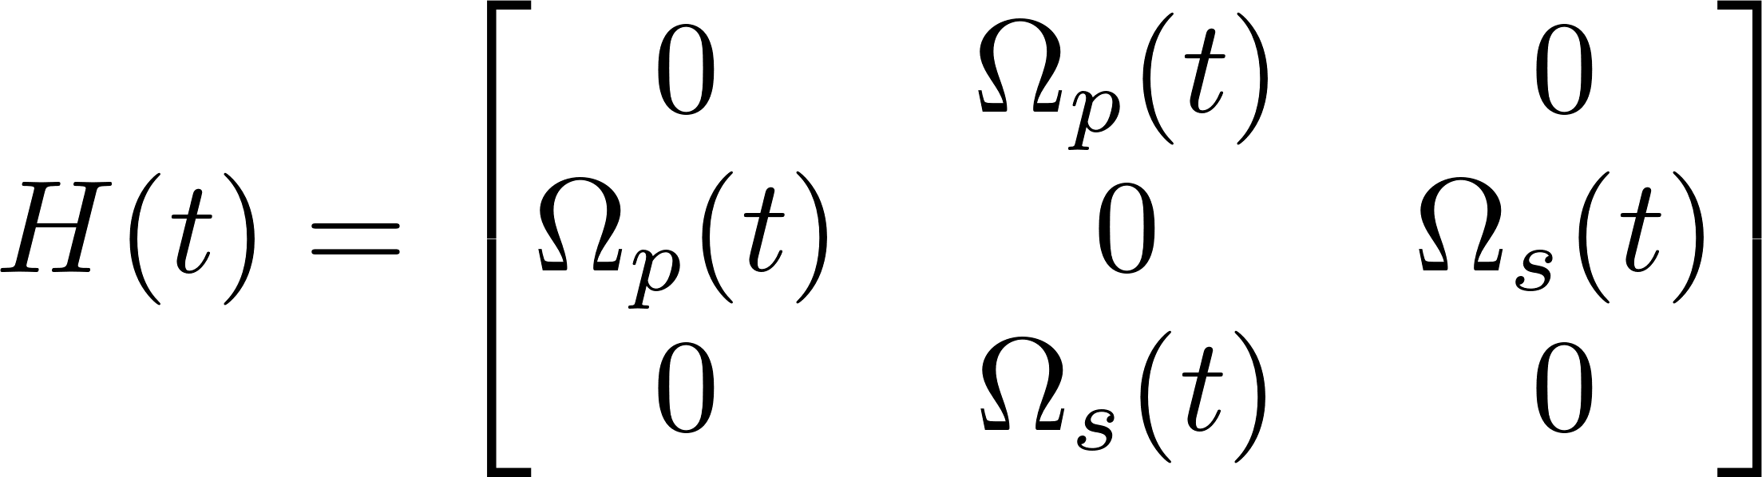
Introduction
Theory
Simulation
Fabrication process
Results and discussions
Conclusion and outlook
High-pass filters based on STIRAP
Final defense
In resonance (without phase mismatch)
Pulse sequence:
counter-intuitive
Adiabatic following:
By spatially varying the pulse overlap, the state vector will stay in the same eigenvector throughout the interaction
Overall device length:
pulse duration + pulse delay
[1] Picturing stimulated Raman adiabatic passage: a STIRAP tutorial," Adv. Opt. Photon. 9, 563-719 (2017)

Slide 24

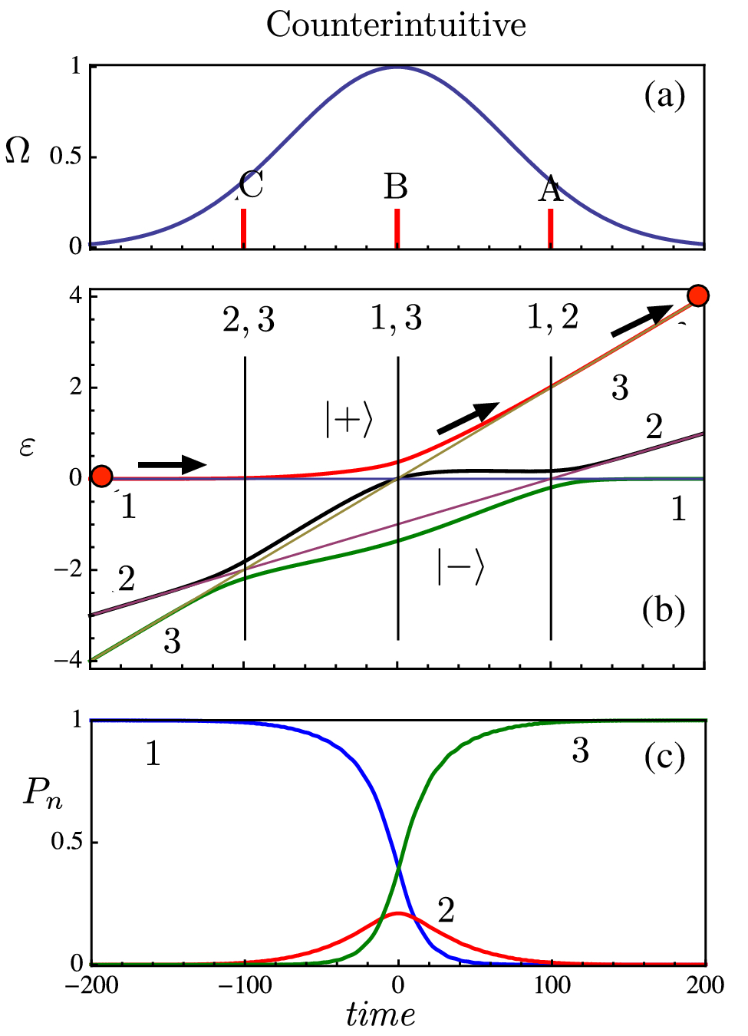
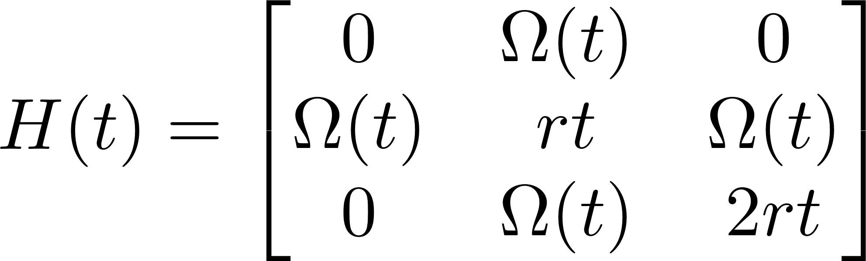
Introduction
Theory
Simulation
Fabrication process
Results and discussions
Conclusion and outlook
High-pass filters based on frequency swept STIRAP
Final defense
Off resonance (with phase mismatch)
Pulse sequence:
Simultaneous
Adiabatic following:
By spatially varying the phase mismatch, the state vector will come across different eigenstates (from ground state to target state)
Overall device length:
pulse duration
[1] Picturing stimulated Raman adiabatic passage: a STIRAP tutorial," Adv. Opt. Photon. 9, 563-719 (2017)

Slide 25
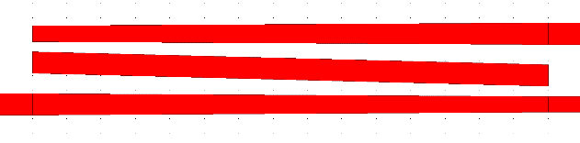

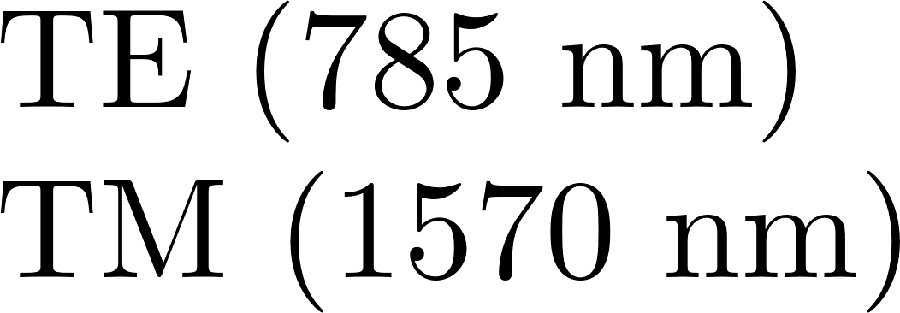

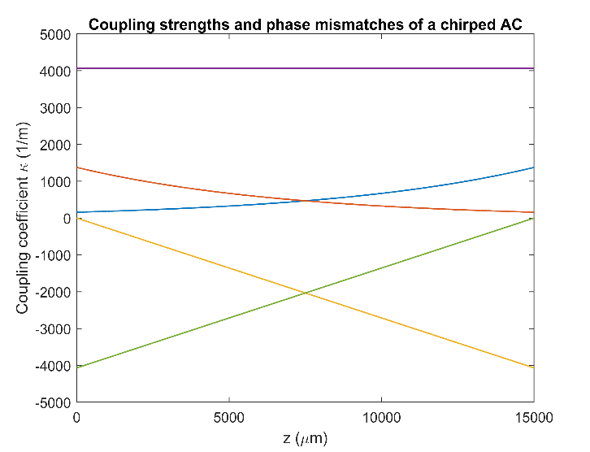
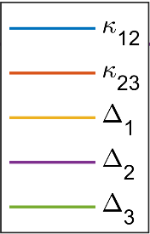
Introduction
Theory
Simulation
Fabrication process
Results and discussions
Conclusion and outlook
High-pass filters based on frequency swept STIRAP
Final defense
The proposed design
Due to the weak coupling strength at shorter wavelength, adiabatic passage only occurs at 1500 ~ 1600 nm (high pass)
The adiabatic following is achieved by spatially varying the coupling strengths between adjacent waveguides and the widths of outer waveguides (introducing phase mismatches)
Based on frequency-swept STIRAP, the spectral filter can be as short as 1.5 cm
Hung-Pin Chung, Kuang-Hsu Huang, Kai Wang, Sung-Lin Yang, Shih-Yuan Yang, Chun-I Sung, Alexander S Solntsev, Andrey A Sukhorukov, Dragomir N Neshev, and Yen-Hung Chen. Asymmetric adiabatic couplers for fully-integrated broadband quantumpolarization state preparation. Scientific Reports, 7(1):1–7, 2017.

Slide 26
Simulation
Final defense

Slide 27


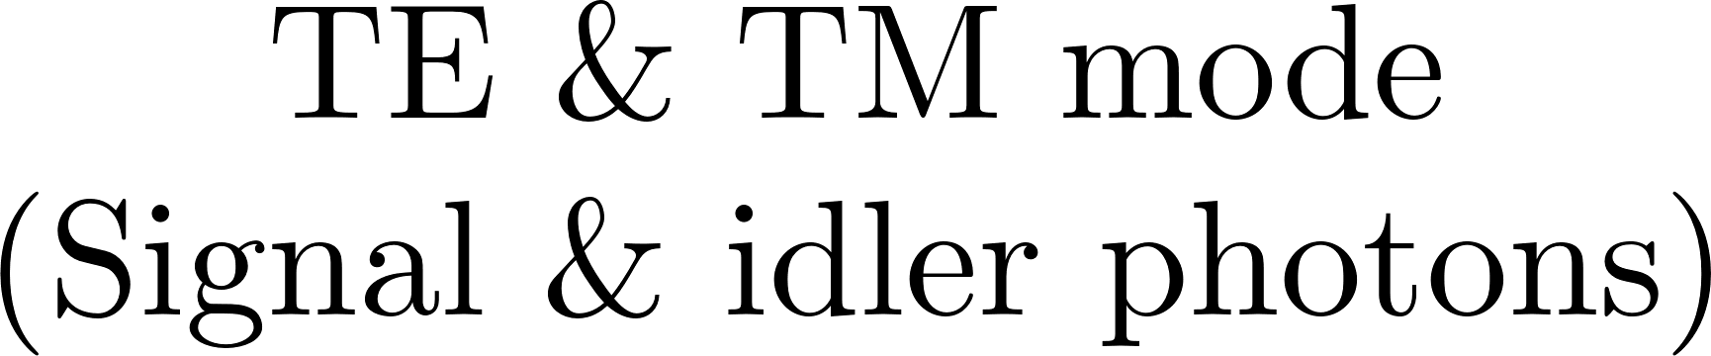













Introduction
Theory
Simulation
Fabrication process
Results and discussions
Conclusion and outlook
The schematic of the proposed PBS
Final defense
Parameters

Slide 28
Introduction
Theory
Simulation
Fabrication process
Results and discussions
Conclusion and outlook
The schematic of the proposed PBS
Final defense
Parameters

Slide 29
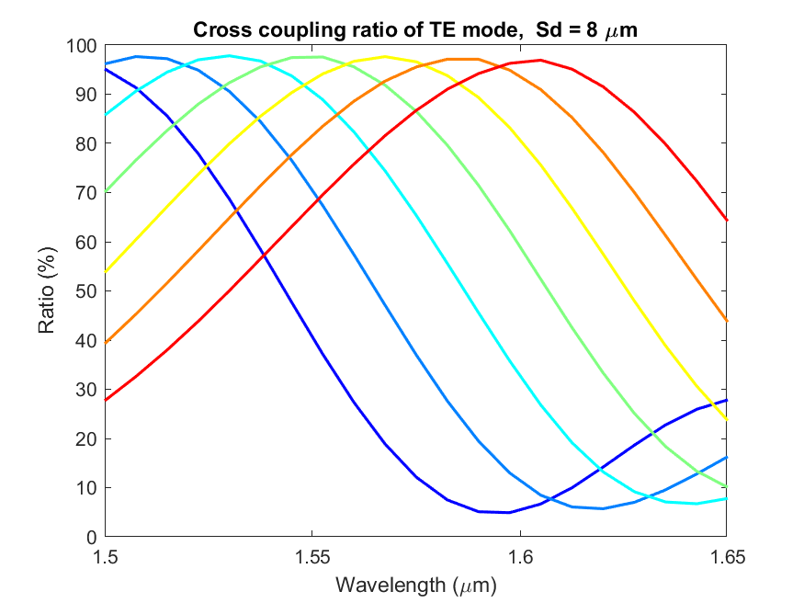
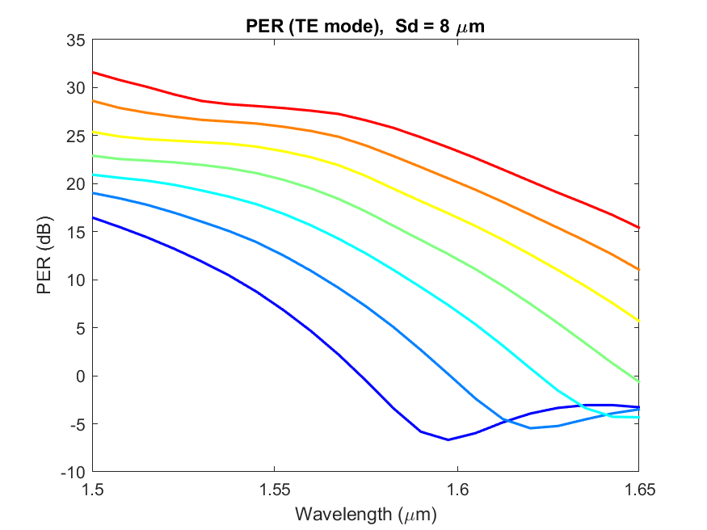
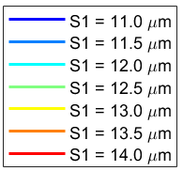
Introduction
Theory
Simulation
Fabrication process
Results and discussions
Conclusion and outlook
Simulation (PBS, TE mode, Sd = 8 μm)
Final defense
Since each coupling section is reduced to half, the transmission spectrum becomes DC-like, however, the broad operation of high PER is still preserved

Slide 30
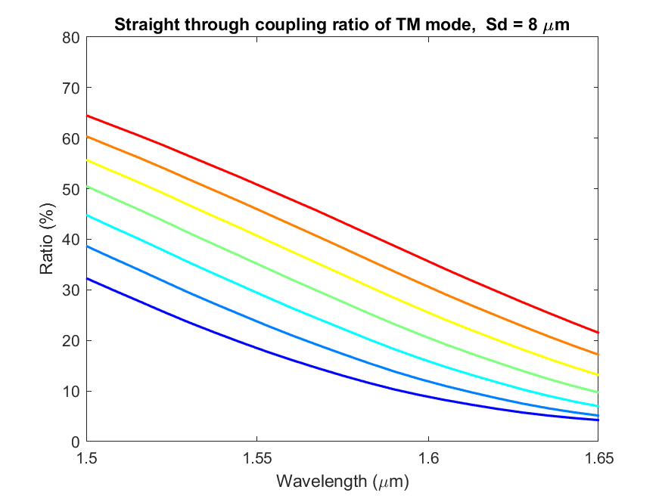
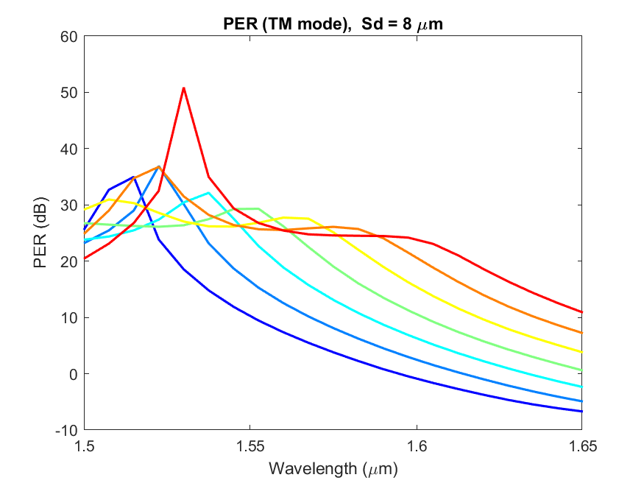
Introduction
Theory
Simulation
Fabrication process
Results and discussions
Conclusion and outlook
Simulation (PBS, TM mode, Sd = 8 μm)
Final defense
Due to the smaller birefringence provided by Ti-diffused waveguides, a half of the TM energy is still cross-coupled to the intermediate waveguides. However, the broad operation of high PER is still guaranteed by the large separation between TE and TM port

Slide 31



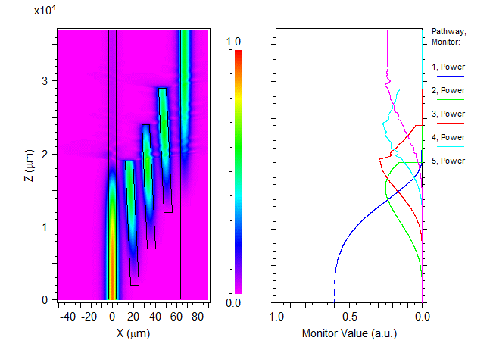
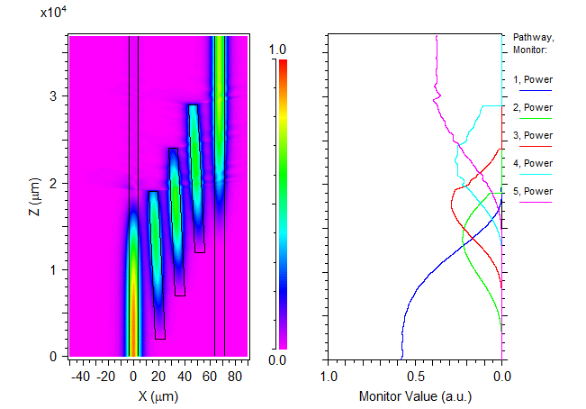
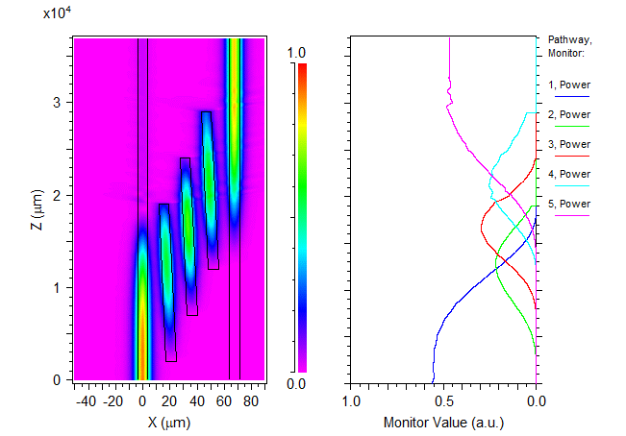



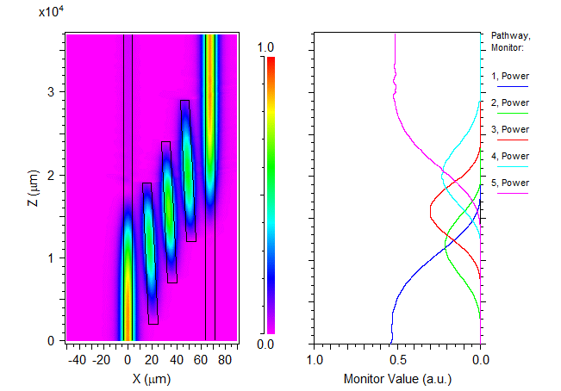

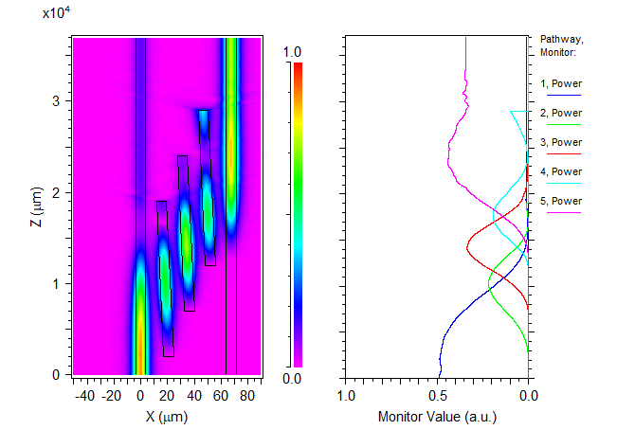
Introduction
Theory
Simulation
Fabrication process
Results and discussions
Conclusion and outlook
Simulation (PBS, BPM, TE input)
Final defense

Slide 32


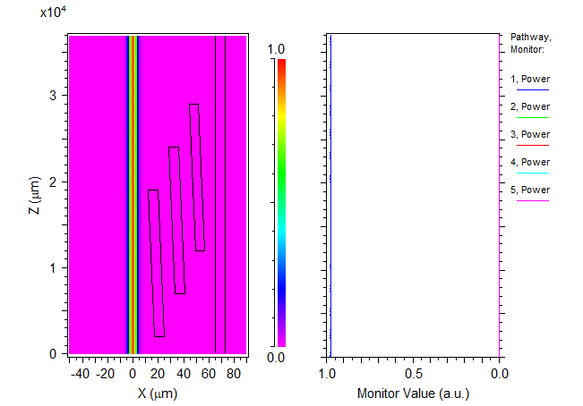
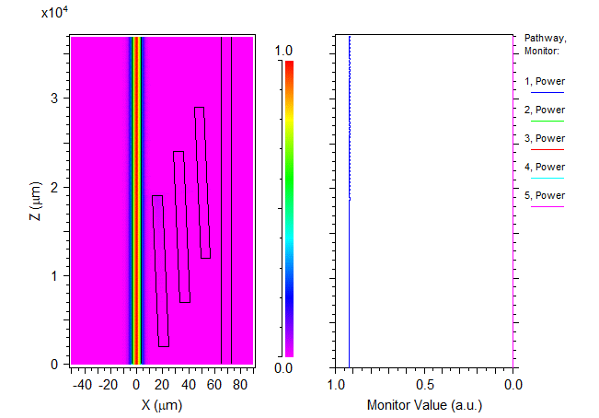


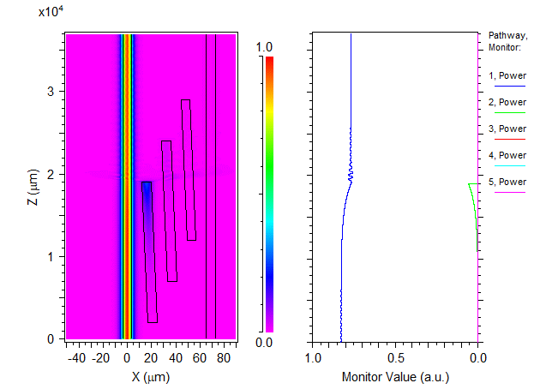
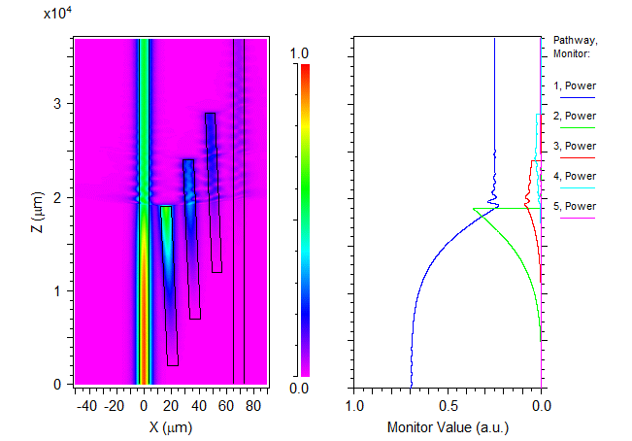
Introduction
Theory
Simulation
Fabrication process
Results and discussions
Conclusion and outlook
Simulation (PBS, BPM, TE input)
Final defense

Slide 33



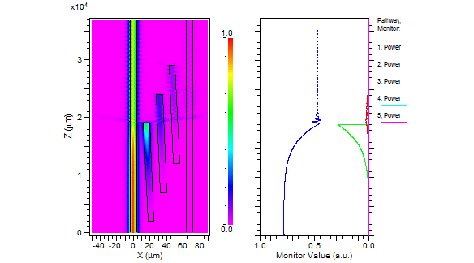








Introduction
Theory
Simulation
Fabrication process
Results and discussions
Conclusion and outlook
Simulation (PBS, BPM, TM input)
Final defense

Slide 34















Introduction
Theory
Simulation
Fabrication process
Results and discussions
Conclusion and outlook
The schematic of the proposed high-pass filter
Final defense
Parameters

Slide 35
Introduction
Theory
Simulation
Fabrication process
Results and discussions
Conclusion and outlook
The schematic of the proposed high-pass filter
Final defense
Parameters

Slide 36




Introduction
Theory
Simulation
Fabrication process
Results and discussions
Conclusion and outlook
Simulation (high-pass filter , TM mode, s_{b2}= 2.5 μm)
Final defense
Since Ti-diffused waveguides provide higher confinement for TM modes, broadband transmissions can be achieved within 1.5 cm

Slide 37


Introduction
Theory
Simulation
Fabrication process
Results and discussions
Conclusion and outlook
Simulation (high-pass filter , TE mode, s_{b2}= 2.5 μm)
Final defense
For shorter wavelengths, the coupling strength is not enough to achieve adiabatic following, the energy remains uncoupled (high-pass filter)

Slide 38






Introduction
Theory
Simulation
Fabrication process
Results and discussions
Conclusion and outlook
Simulation (spectral filter, BPM, TM input)
Final defense

Slide 39




Introduction
Theory
Simulation
Fabrication process
Results and discussions
Conclusion and outlook
Simulation (spectral filter, BPM, TE input)
Final defense

Slide 40
Fabrication process
Final defense

Slide 41




Introduction
Theory
Simulation
Fabrication process
Results and discussions
Conclusion and outlook
Overall fabrication process
Final defense

Slide 42





Introduction
Theory
Simulation
Fabrication process
Results and discussions
Conclusion and outlook
Titanium in-diffusion
Final defense

Slide 43










Introduction
Theory
Simulation
Fabrication process
Results and discussions
Conclusion and outlook
Electric field poling
Final defense

Slide 44




Introduction
Theory
Simulation
Fabrication process
Results and discussions
Conclusion and outlook
Microscope images
Final defense
Lithography of waveguide patterns
Lift-off after Ti-deposition
Titanium in-diffusion
Electric field poling

Slide 45
Results and discussions
Final defense

Slide 46
Introduction
Theory
Simulation
Fabrication process
Results and discussions
Conclusion and outlook
Experimental setup for SFG measurement
Final defense
Polarization controller (PC)
The polarization of the input light is adjusted to 45° polarized, which gives idler (TM) and single (TE) waves
Tunable laser source (1500 ~1600 nm)
SM fiber
Oven (with temperature controller)
Objective lens
Low pass filter
Power meter
Carrier block
Chip
Chip 1

Slide 47


Introduction
Theory
Simulation
Fabrication process
Results and discussions
Conclusion and outlook
Tuning curves of SFG
Final defense
The measured temperature tuning rate is ~ -0.2 nm/°C. Since SFG is an reverse process of SPDC, the operating temperatures can be characterized by the measured tuning curves

Slide 48





Introduction
Theory
Simulation
Fabrication process
Results and discussions
Conclusion and outlook
Joint spectrum
Final defense
Since we only have one tunable laser source, the measured data only represents the diagonal line of the phase matching diagram
If two tunable laser sources are used, the phase matching diagram can be fully constructed, and we can use it to calculate the joint spectral intensity of the single photon source, which gives the correlation of photon pairs and the spectral purity
×
=

Slide 49

Introduction
Theory
Simulation
Fabrication process
Results and discussions
Conclusion and outlook
SFG power dependence
Final defense
Since the conversion is fairly weak, the output SFG power shows a clear quadratic dependency on the input power

Slide 50
Introduction
Theory
Simulation
Fabrication process
Results and discussions
Conclusion and outlook
Experimental setup for ER/PER measurement
Final defense
Polarization controller (PC)
Tunable laser source (1500 ~1600 nm)
SM fiber
Oven (with temperature controller)
Objective lens
TE mode
Power meter
Carrier block
Chip
TM mode
Chip 2
Knife edge

Slide 51


Introduction
Theory
Simulation
Fabrication process
Results and discussions
Conclusion and outlook
Measured transmission and PER spectra (TE input, no. 1-3)
Final defense
The measured transmission of TE mode are in great agreement with the theoretically predicted one with a 0.75 μm width deviation. All the transmissions are normalized by subtracting coupling loss and propagation loss (around 3 dB).
However, the presence of unfiltered background noise introduced by scattering and free-space coupling limits the highest PER to 15 dB level (flattened response)

Slide 52


Introduction
Theory
Simulation
Fabrication process
Results and discussions
Conclusion and outlook
Measured transmission and PER spectra (TM input, no. 1-3)
Final defense
Positive width deviation results in higher transmission of TM modes
The spectral response fits well with the calculated one in the region where PER < 15 dB

Slide 53


Introduction
Theory
Simulation
Fabrication process
Results and discussions
Conclusion and outlook
Measured ER spectra (TM input, no. 1-3)
Final defense
Unlike the proposed PBS, the ER of the spectral filter is more sensitive to width deviation. The calculated tolerance is estimated as 0.5 μm. However, the results still fit well with simulations

Slide 54


Introduction
Theory
Simulation
Fabrication process
Results and discussions
Conclusion and outlook
Experimental setup for coincidence counting
Final defense
This experiment was performed in quantum photonics laboratory led by professor Chuu
Polarization controller (PC)
785 nm
Volume-Holographic-Grating- (VHG) Stabilized SF Laser
SM fiber
Oven (25 °C)
Objective lens
Pump filter
Pump filter
PBS
SPD
Triggering signals
Carrier block
Chip
Idler photons (1519 nm)
Chip 1, 4.5 μW input
(coupling loss subtracted)
In this measurement, we used samples with input facet fiber-pigtailed, which can only withstand a temperature below 85 °C , therefore the coincidence measurement was performed at non-degenerate conditions.
Signal photons (1624 nm)
Triggered SPD

Slide 55

Introduction
Theory
Simulation
Fabrication process
Results and discussions
Conclusion and outlook
Coincidence peak
Final defense
The result shows clear coincidence peak, which directly proves the successful generation of photon pairs. The 25 ns offset comes from the optical path difference between signal and idler arms.

Slide 56





Introduction
Theory
Simulation
Fabrication process
Results and discussions
Conclusion and outlook
Calculation of pair generation rate
Final defense
From the measured count rates at two detectors and the coincidence count rate calculated from the coincidence peak, we can get the pair generation rate of the source
OR

Slide 57
Introduction
Theory
Simulation
Fabrication process
Results and discussions
Conclusion and outlook
Loss calculation
Final defense
Conversion losses:
Polarization controller (PC)
No | TE (dB) | TM (dB)
1 | -9.78 | -1.87
Transmission and coupling losses:
785 nm
Volume-Holographic-Grating- (VHG) Stabilized SF Laser
No | TE (dB) | TM (dB)
2 | -0.06 | -0.30
3 | -0.03 | -0.05
4 | -0.82
5 | -6.02
6 |  | -3.01
Overall (1~6) | -16.71 | -5.23
SM fiber
1
2
3
4
5
Oven (25 °C)
Pump filter
Pump filter
PBS
SPD
Triggering signals
Carrier block
Chip
Idler photons (1519 nm)
Detection efficiency
TE (%) | TM (%)
~ 15% | ~ 5%
Signal photons (1624 nm)
Triggered SPD
6

Slide 58
Introduction
Theory
Simulation
Fabrication process
Results and discussions
Conclusion and outlook
Calculation of pair generation rate
Final defense
 | Other group* | Our measurement
μ₁ (dB) | -10.4576 | -16.71
μ₂ (dB) | -10 | -5.23
η₁ (%) | 15 | 15
η₂ (%) | 15 | 5
μ₁ μ₂ η₁ η₂ (dB) | -36.94 | -43.19
Pump power (μW) | 95 | 4.5
R (1/s) | 1000 (5 cm long) | 0.613 (1.5 cm long)
N (1/s) | 4.94*10⁶ | 1.28*10⁴
N/pump power⋅cm (1/s⋅mW⋅cm) | 1.04*10⁷ | 1.89*10⁶
After considering all the possible losses in the measurement, our normalized pair generation rate is still 5.50 times smaller than that measured by the other group, the loss of count rate must come from elsewhere
*. Thomas, A., 2011. Photon Pair Sources in Periodically Poled Ti: LiNbO3 Waveguides (Doctoral dissertation, Universitätsbibliothek).

Slide 59





Introduction
Theory
Simulation
Fabrication process
Results and discussions
Conclusion and outlook
Calculation of joint spectral intensity
Final defense
The linewidth of our pump laser is ~ 0.0113 nm, which severely filters the JSI ,if it’s around 0.1 nm level, the estimated integral of JSI is 9 times greater.
The JSI of our source
The JSI of our source
using 0.1 nm linewidth pump laser
Thomas, A., 2011. Photon Pair Sources in Periodically Poled Ti: LiNbO3 Waveguides (Doctoral dissertation, Universitätsbibliothek).

Slide 60
Introduction
Theory
Simulation
Fabrication process
Results and discussions
Conclusion and outlook
Calculation of pair generation rate
Final defense
 | Other group* | Our measurement
μ₁ (dB) | -10.4576 | -16.71
μ₂ (dB) | -10 | -5.23
η₁ (%) | 15 | 15
η₂ (%) | 15 | 5
μ₁ μ₂ η₁ η₂ (dB) | -36.94 | -43.19
Pump power (μW) | 95 | 4.5
R (1/s) | 1000 (5 cm long) | 0.613 (1.5 cm long)
N (1/s) | 4.94*10⁶ | 1.28*10⁴
N/pump power⋅cm (1/s⋅mW⋅cm) | 1.04*10⁷ | 1.89*10⁶ => 1.70*10⁷ (using 0.1 nm linewidth laser)
Taking JSI into account, the normalized pair generation rate is roughly around the same level as presented by the other group, which indirectly verifies the successful demonstration of our single photon source
*. Thomas, A., 2011. Photon Pair Sources in Periodically Poled Ti: LiNbO3 Waveguides (Doctoral dissertation, Universitätsbibliothek).

Slide 61

Introduction
Theory
Simulation
Fabrication process
Results and discussions
Conclusion and outlook
Calculation of pair generation rate
Final defense
 | Our measurement
μ₁ (dB) | -16.71
μ₂ (dB) | -5.23
η₁ (%) | 15
η₂ (%) | 5
μ₁ μ₂ η₁ η₂ (dB) | -43.19
Pump power (μW) | 4.5
R(1/s) | 0.613 (1.5 cm long)
S₁ (1/s)
S₂ (1/s) | 7000
D₁ (1/s) | 2000 ~ 3000
D₂ (1/s) | 2000 ~ 3000
OR
Due to the presence of unfiltered pump photons in the spectral range > 850 nm, the coincidence count rate in the idler arm couldn’t be used to calculate the generation rate

Slide 62
Conclusion and outlook
Final defense

Slide 63
Introduction
Theory
Simulation
Fabrication process
Results and discussions
Conclusion and outlook
Contribution
Final defense
In this study, we have successfully demonstrated:
An novel design of highly fabrication tolerant and broadband PBS. The measured bandwidths for PER_{TE} ≥ 15 dB and PER_{TM} ≥ 15 dB are as large as 140 nm and 100 nm, respectively, even with the presence of near 1 μm width deviation.
The first fully-integrated HSPS on Ti-diffused waveguides. The measured normalized pair generation rate is around 1.89*10⁶ (1/s⋅mW⋅cm) and is mainly limited by the narrow linewidth of our pump laser.
The remaining problems:
PBS
DC-like transmission of TE modes due to the shortened coupling length
Unwanted energy loss of TM modes due to the relatively smaller birefringence
The background noise that restricts the highest PER to 15 dB level
Single photon source
The presence of unfiltered pump photons at longer wavelength range (> 850 nm)
Nondegenerate operation

Slide 64



Introduction
Theory
Simulation
Fabrication process
Results and discussions
Conclusion and outlook
APE-Ti based adiabatic couplers
Final defense
By utilizing the natural polarization isolation provided by APE waveguides, the adiabatic passage can be achieved without sacrificing the energy of both polarizations, which greatly improves the performance while preserving the ultra-broadband operation.

Slide 65




Introduction
Theory
Simulation
Fabrication process
Results and discussions
Conclusion and outlook
BPM results
Final defense
Using APE-Ti waveguides, the broadband conversion can be potentially achieved without sacrificing the energy of TE and TM modes. However, more experimental data of the dispersion of APE waveguides is still needed

Slide 66
Thank
you
Final defense
Thank you

